Slide 1
NLify Lightweight Spoken Natural Language Interfaces via Exhaustive Paraphrasing
Seungyeop Han U. of Washington
Matthai Philipose, Yun-Cheng Ju Microsoft

Slide 2
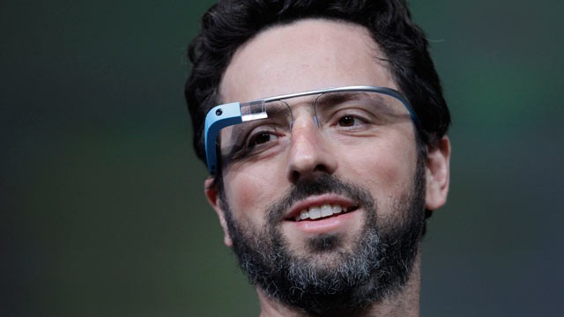
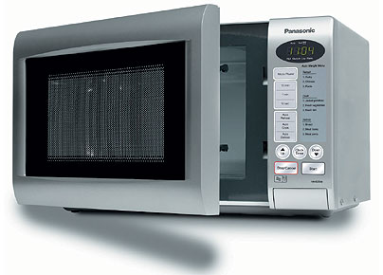
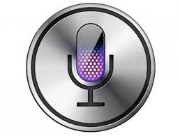
Speech-Based UIs are Here
Today
Today
Tomorrow
Siri, …
Hey Glass, …
Hey Microwave, …

Slide 3
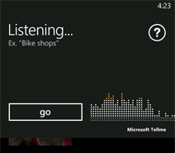
Keyphrases Don’t Scale
App1
What time is it?
Keyphrase Hell
App2
Next bus to Seattle
App3
Tomorrow’s weather
…
App26
When is the next meeting
App50
…
“What time is the next meeting”
…
Use Spoken Natural Language

Slide 4
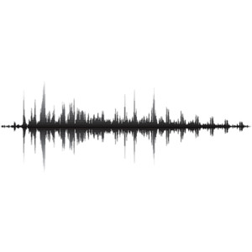
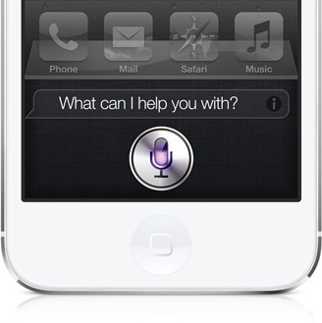
Spoken Natural Language (SNL) Today: First-party Applications
“Hey, Siri.
Do you love me?”
Speech Recognition
Text: “Hey Siri…”
“I’m not allowed, Seungyeop”
…
Language
Processing
Personal assistant model
Large speech engine (20-600GB)
Experts mapping speech to a few domains

Slide 5
NLify: Scaling Spoken NL Interfaces
# apps
1st party app (e.g., Xbox, Siri)
multiple PhDs, 10s of developers
10
3rd party app (e.g., intuit, spotify)
0 PhDs, 1-3 developers
10,000
end-user macro (e.g., ifttt.com)
0 PhDs, 0 developers
10,000,000

Slide 6
Goal
Make
programming spoken natural language interfaces
as easy and robust as
programming graphical user interfaces

Slide 7
Outline
Motivation / Goal
System Design
Demonstration
Evaluation
Conclusion

Slide 8
Challenges
Developers are not SNL experts
Applications are developed independently
Cloud-based SNL does not scale as UI
UI capability must not rely on connectivity
UI events must have minimal cost

Slide 9
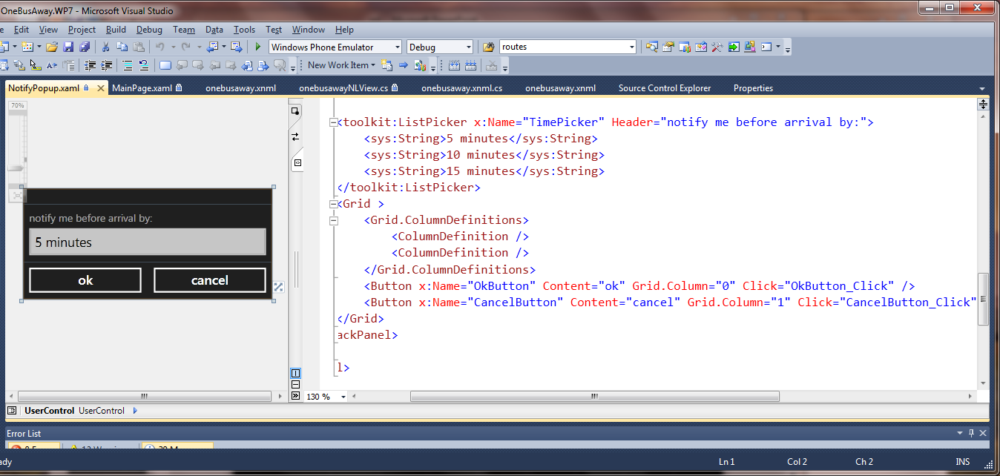
Specifying GUIs
Intuitive definition of UI
handler linking to code

Slide 10
Specifying Spoken Keyphrase UIs
<CommandPrefix>Magic Memo</CommandPrefix>
<Command Name="newMemo"> <ListenFor>Enter [a] [new] memo</ListenFor> <ListenFor>Make [a] [new] memo</ListenFor> <ListenFor>Start [a] [new] memo</ListenFor> <Feedback>Entering a new memo</Feedback> <Navigate Target=“/Newmemo.xaml”> </Command>
...
How does natural language differ from keyphrases?

Slide 11
Difference 1: Local Variation
Missing words
Repeated words
Re-arranged words
New combinations of phrases
When is next meeting?
When is the next.. next meeting?
When is the next meeting?
When the next meeting is?
What time is the next meeting?

Slide 12
Difference 2: Paraphrases
show me the current time
what is the time
time
what is the current time
may i know the time please
give time
show me the time
show me the clock
tell me what time it is
what is time
current time
tell what time it is
list the time
what time
what time it is now
show current time
what time please
show time
what is the time now
current time please
say the time
find the current time please
what time is it
what is current time
what time is it tell me
time current
what's the time
tell current time
what time is it now
what time is it currently
check time
the time now
tell me the current time
what's time
time now
tell me the time
can you please tell me what time it is
tell me current time
give me the time
time please
show me the time now

Slide 13
Specifying SNL Systems
Speech Recognition
Language
Processing
“what time is it?”
whattime()
Lots of rules, little data
Encode local variation in grammar
Encode domain knowledge on paraphrases in models e.g. CRFs
Few rules, lots of data
Use statistical language models that require little anticipation of local noise
Use data-driven models that require little domain knowledge

Slide 14
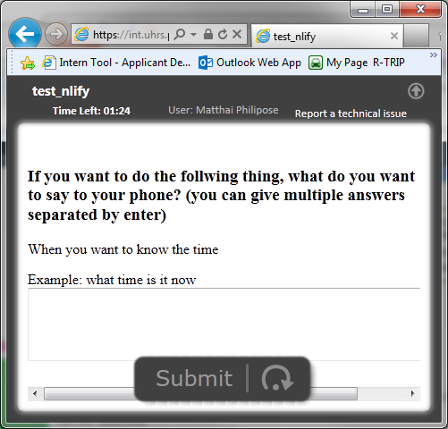
Exhaustive Paraphrasing by Automated Crowdsourcing
Handler: whattime()
Description: When you want to know the time
Examples:
What time is it now
What’s the time
Tell me the time
directions
following task,
Handler: whattime()
Description: When you want to know the time
Examples:
What time is it now
What’s the time
Tell me the time
Current time
Find the current time please
Time now
Give me time
…
Examples from developers
description
example
Automatically generated crowdsourcing

Slide 15
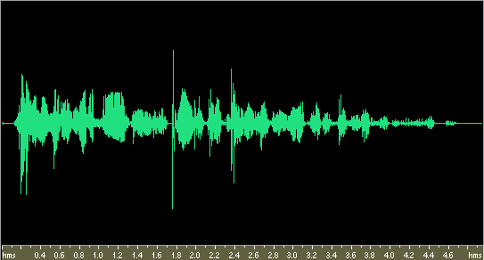
Compiling SNL Models
.What is the date @d
.Tell me the date @d
…
Seed Examples
Internet crowdsourcing service
amplify
.What is the date @d
.Tell me the date @d
.What date is it @d
.Give me the date @d
.@d is what date
…
Amplified Examples
dev time
compile
install time
SLM
Nearest neighbormodel
Statistical Models
nlwidget
run time
SAPI
“Tell me when it’s @T=20 min …”
TFIDF + NN
NLNotifyEvent e

Slide 16
SNL Models for Multiple Apps
Application 1
Application 2
Application N
Amplified
Examples
.What is the date @d
.Tell me the date @d
.What date is it @d
.Give me the date @d
.@d is what date
…
.How much is @com
.Get me quote for @com
.What’s the price for @com
…
…
dev time
compile
Statistical
Models
Nearest neighbor model
SLM
install time
nlwidget
SAPI
“Tell me when it’s @T=20 min …”
TFIDF + NN
run time
NLNotifyEvent e
Apps developed separately => “late assembly” of models
Limited time for learning at install time => simple (e.g., NN) models
Users no longer say anything but what they have installed => “natural language shortcut” mental model

Slide 17
Outline
Motivation / Goal
System Design
Demo: SNL interfaces in 4 easy steps
Evaluation
Conclusion

Slide 18
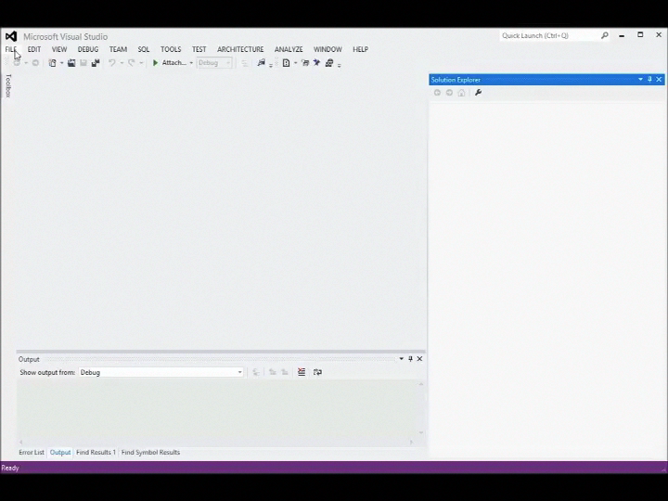
1. Add NLify DLL

Slide 19
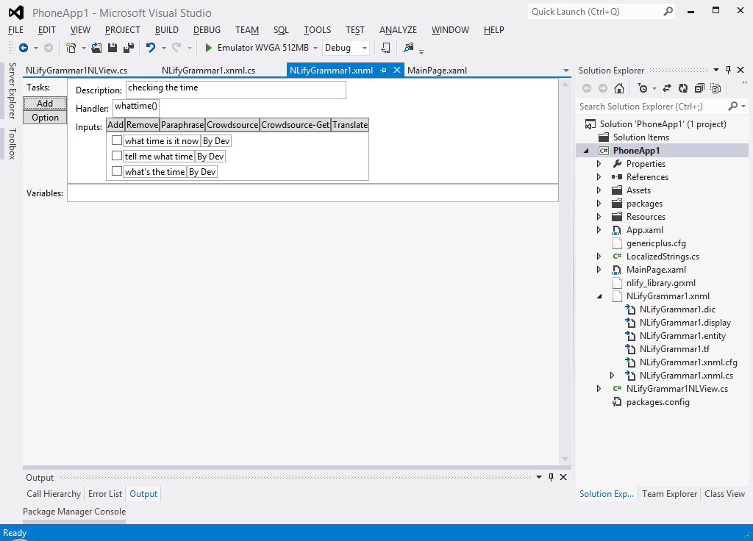
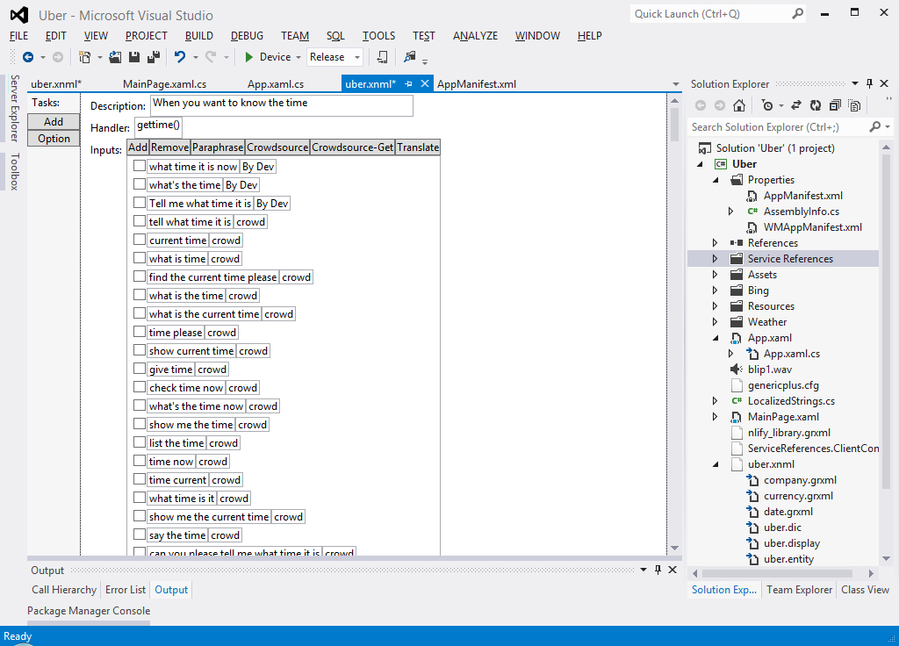
2. Providing Examples

Slide 20
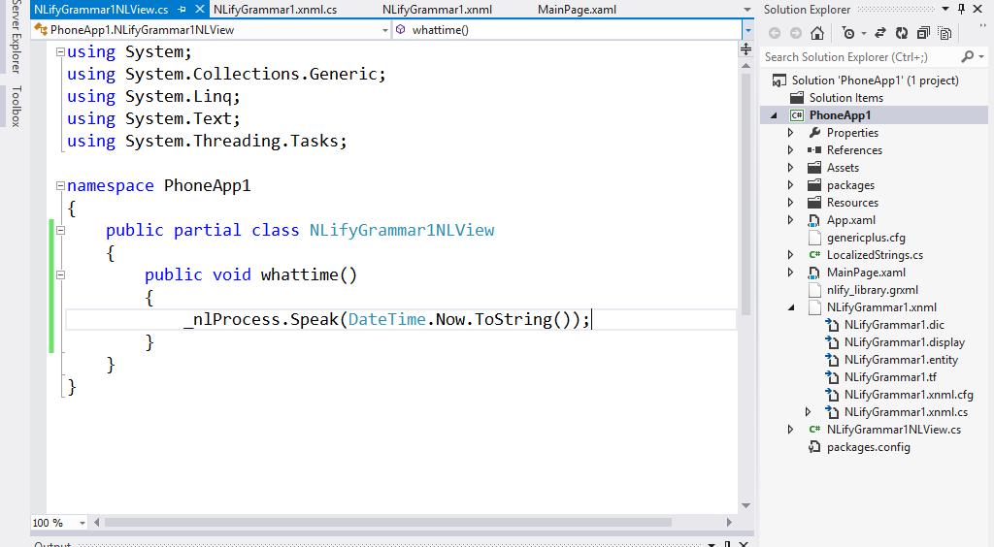
3. Writing a Handler

Slide 21
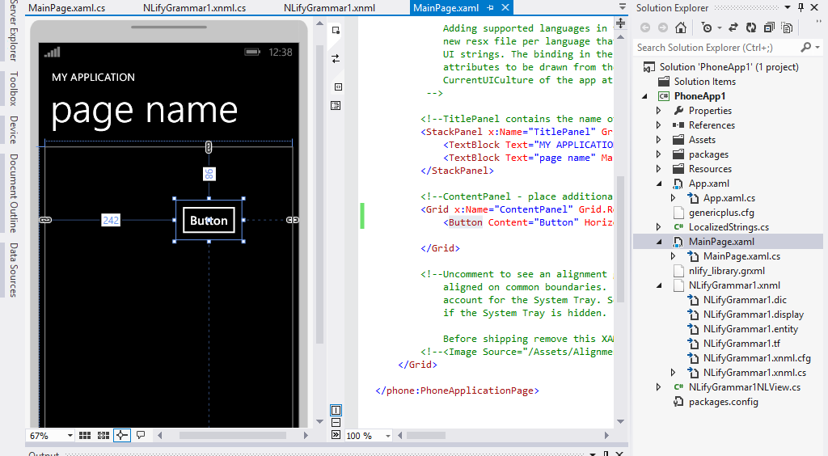
4. Adding a GUI Element

Slide 22
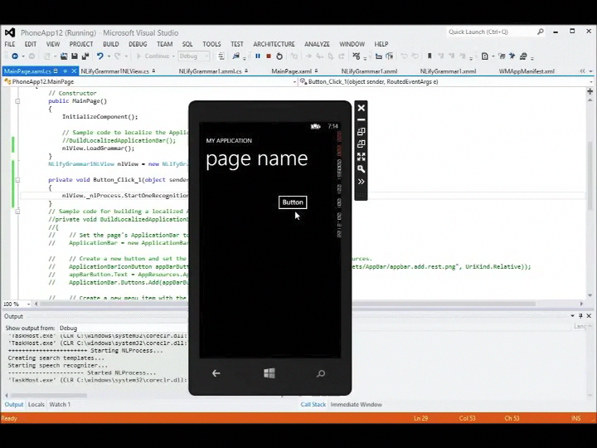
Enjoy ☺

Slide 23
Outline
Motivation / Goal
System Design
Demonstration
Evaluation
Conclusion

Slide 24
Evaluation
How good are SNL recognition rates?
How does performance scale with commands?
How do design decisions impact recognition?
How practical is on-phone implementation?
What is the developer experience?

Slide 25
Evaluation Dataset
Domain | Intent & Slots | Example
Clock | FindTime() | What time is it?
 | FindDate(day) | What’s the date today?
Calendar | CheckNextMtg() | What’s my next meeting?
Bus | FindNextBus(route, dest) | When is the next 20 to Seattle?
Finance | FindStockPrice(company) | How much is Microsoft stock?
 | CaculateTip(Money, NumPeople) | How much is the tip for $20 for three people
Condition | FindWeather(day) | How is the weather tomorrow?
Contacts | FindOfficeLocation(person) | Where is the Janet Smith’s office?
 | FindGroup(person) | Which group does Matthai work in?
Across 27 different commands,
collected 1612 paraphrases, 3505 audio samples
…

Slide 26

Evaluation Dataset
Seed
5 paraphrases/intent
By authors
Crowd
~60 paraphrases/intent
By Crowd
Amplify via
Crowdsourcing
$.03/paraphrase
Training
Testing
Audio
130 utterance/intent
By 20 subjects
Asking “What would you say to the phone to
do the described task” with an example

Slide 27
Overall Recognition Performance
Absolute recognition rate is good (avg: 85%, std: 7%)
Significant relative improvement from Seed (69%)

Slide 28
Performance Scales Well with Number of Commands

Slide 29
Design Decisions Impact Recognition Rates
The more exhaustive paraphrasing the better:
Statistical model improves recognition rate by 16% vs. deterministic model

Slide 30
Feasibility of Running on Mobiles
NLify is competitive with a large vocabulary model
Memory usage is acceptable: maximum memory for 27 intents was 32M
Power consumption very close to listening loop
[Average]
SLM: 85%
LV: 80%

Slide 31
Developer Study w/ 5 Devs
Asked to add Nlify into the existing programs
Description | Sample commands | Original LOC | Time Taken
Control a night light | “turn off the light” | 200 | 30 mins
Get sentiment on Twitter | “review this” | 2000 | 30 mins
Query, control location disclosure | “where is Alice?” | 2800 | 40 mins
Query weather | “weather tomorrow?” | 3800 | 70 mins
Query bus service | “when is next 545 to Seattle?” | 8300 | 3 days
(+) How well did NLify’s capabilities match your needs?
(-) Did the cost/benefit of Nlify scale?
(-) How long do you think you can afford to wait crowdsourcing

Slide 32
Conclusions
It is feasible to build mobile SNL systems, where:
Developers are not SNL experts
Applications are developed independently
All UI processing happens on the phone
Fast, compact, automatically generated models enabled by exhaustive paraphrasing are the key.
Notes:
So in sum, it is feasible to build mobile spoken natural language systems where
Developers are not experts, applications are independently developed, and all UI processing happens on the phone.
And here the key is having fast compact and automatically generated models which are enabled by the exhaustive paraphrasing.

Slide 33
For Data and Code
Check Matthai’s Homepage.
http://research.microsoft.com/en-us/people/matthaip/
Or e-mail the authors
On/after October 1.

